Slide 1





SALFORD & CO.
AGROMATE
EMPOWERING FARMERS WITH AI AND INSIGHTS
CODEX

Slide 2
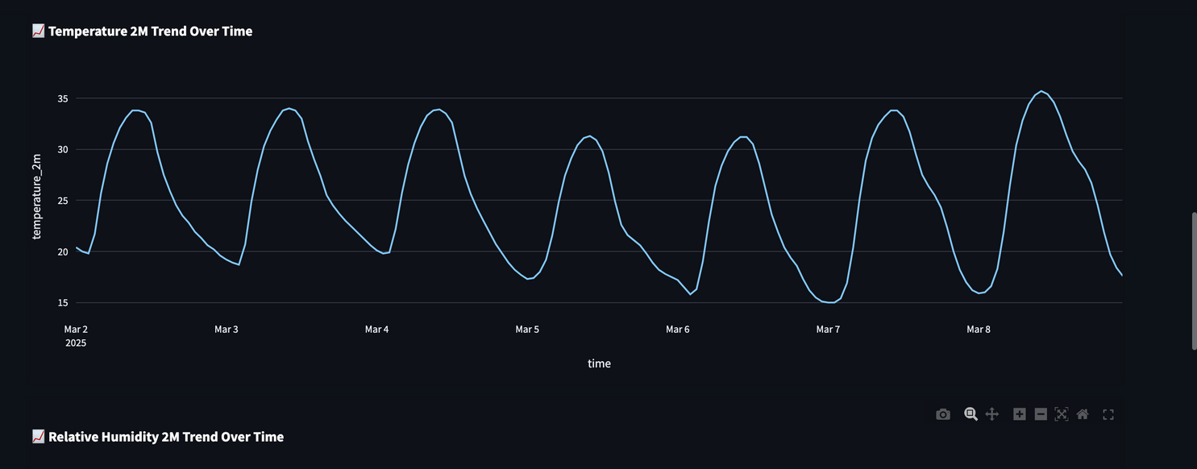
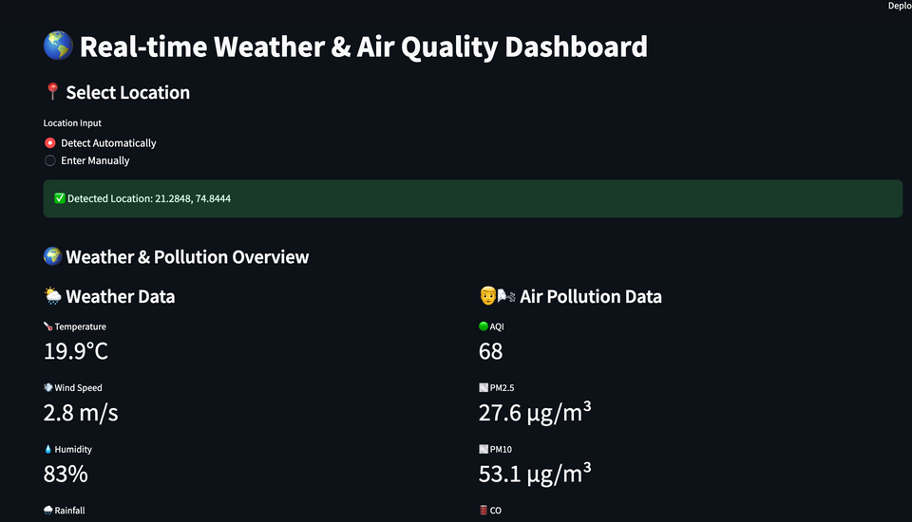
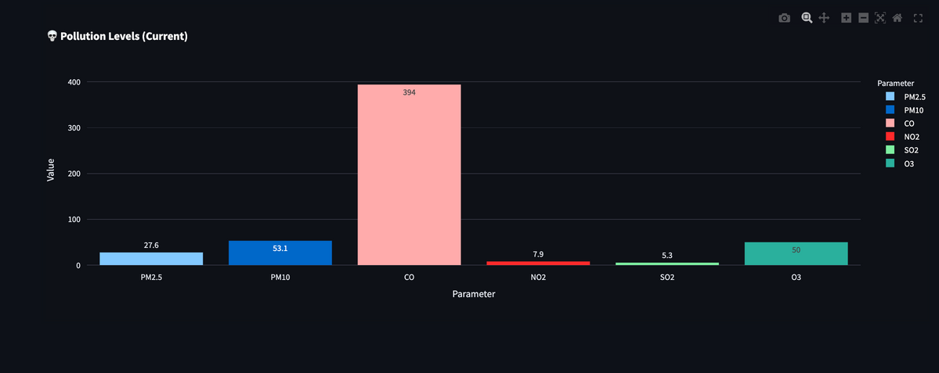
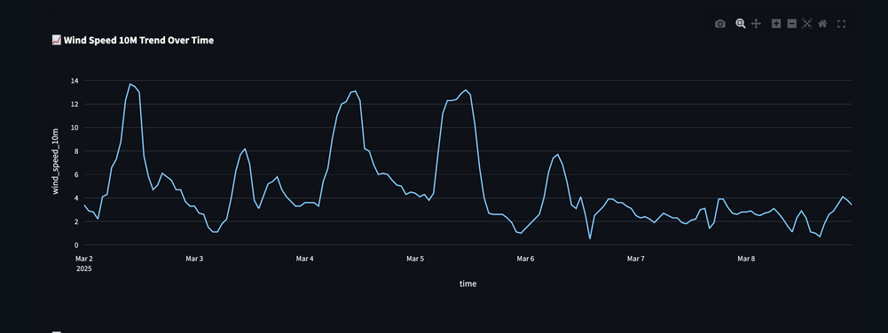


CODEX
INTERACTIVE DASHBOARD
AgroMate’s real-time interactive dashboard provides farmers with live weather and pollution insights to help protect their crops. It fetches key data like temperature, wind speed, humidity, rainfall, and AQI levels (PM2.5, PM10, CO, NO2, SO2, O3).
📊 Key Features:
Live Weather & Air Quality Updates
Line Graphs for tracking weather trends
Bar Charts for pollution analysis
Map Integration for location-based insights
With this data-driven approach, farmers can make informed decisions to improve crop health and yield. 🌱🚜

Slide 3
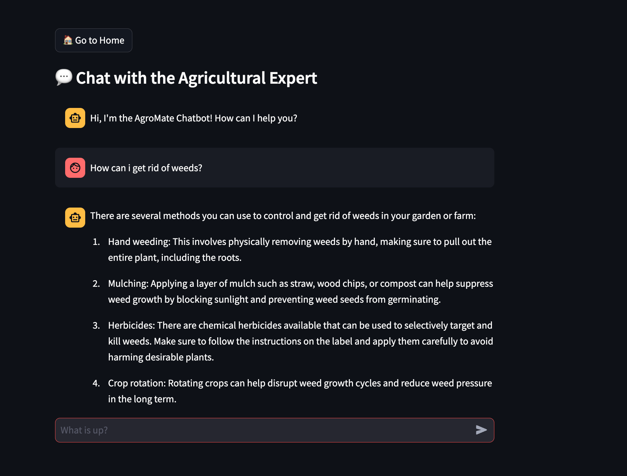

AGRI EXPERT CHATBOT
🤖 Agri Expert Chatbot
AgroMate features an AI-powered chatbot that helps farmers with real-time agricultural advice. Farmers can:
✅ Ask about crop diseases, treatments, and prevention
✅ Get recommendations based on uploaded images
✅ Learn best farming practices and weather impacts
This chatbot ensures instant support, making farming smarter and more efficient. 🌾🚜

Slide 4
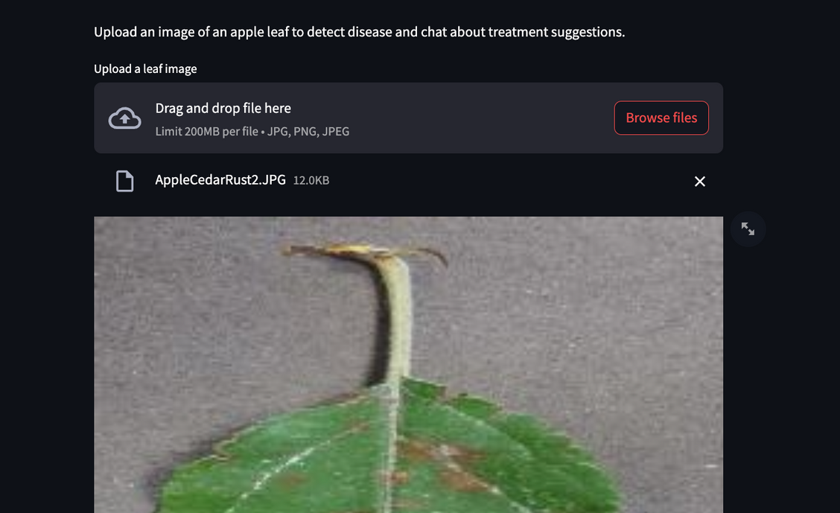


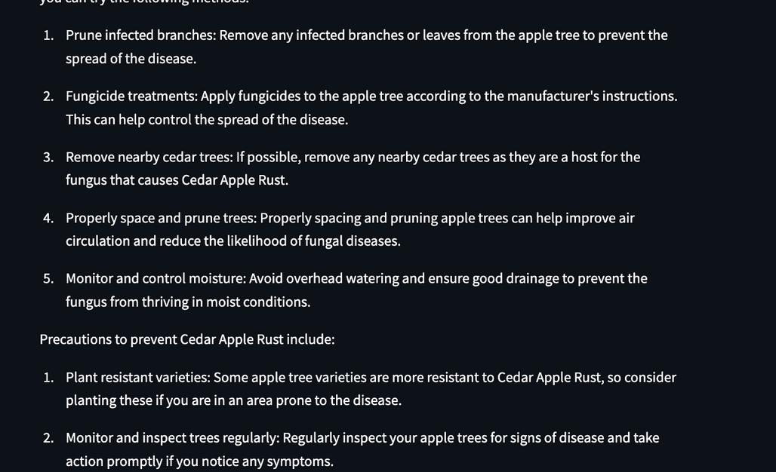


COMPUTER VISION MODELS & CHAT
MODEL
🖥️ AI-Powered Disease Detection
AgroMate uses 9 trained computer vision models to detect 21 crop diseases across 9 crops with high accuracy. Farmers can upload plant images, and the AI instantly identifies the disease, providing:
✅ Accurate Diagnosis
✅ Treatment & Precaution Suggestions
✅ Chatbot Assistance for Further Guidance
This AI-driven approach helps farmers take quick action to protect their crops. 🌿📸
IMAGE CHAT
🖼️ Chat with Your Image
AgroMate allows farmers to chat with the AI based on their uploaded plant image. After detecting the disease, the chatbot provides:
✅ Detailed explanation of the disease
✅ Treatment & prevention tips
✅ Follow-up guidance for better crop care
This feature makes disease diagnosis more interactive and personalized, ensuring farmers get the right support instantly. 🌾🤖

Slide 5



SALFORD & CO.
OUR SERVICES
REALTIME DASHBOARD
POWERFUL IMAGE PREDICTOR & CHATBOT
MULTI LINGUAL CHATBOT
The AI-powered chatbot supports multiple languages, making agricultural advice accessible to farmers worldwide. They can ask questions about crop diseases, treatments, weather conditions, and best farming practices in their preferred language. The chatbot provides instant, expert-backed responses, ensuring farmers get the right guidance anytime, anywhere.
groMate’s interactive dashboard provides live weather and pollution updates, helping farmers monitor temperature, humidity, wind speed, and rainfall, along with air quality indicators like AQI, PM2.5, PM10, CO, NO2, SO2, and O3. With visual graphs, bar charts, and map integration, farmers can make data-driven decisions to protect their crops.
AgroMate uses advanced computer vision models to detect 21 diseases across 9 crops with high accuracy. Farmers can upload an image, and the AI instantly diagnoses the disease, provides treatment suggestions, and allows them to chat with the bot for further guidance. This feature ensures quick and reliable crop health management.

Slide 6
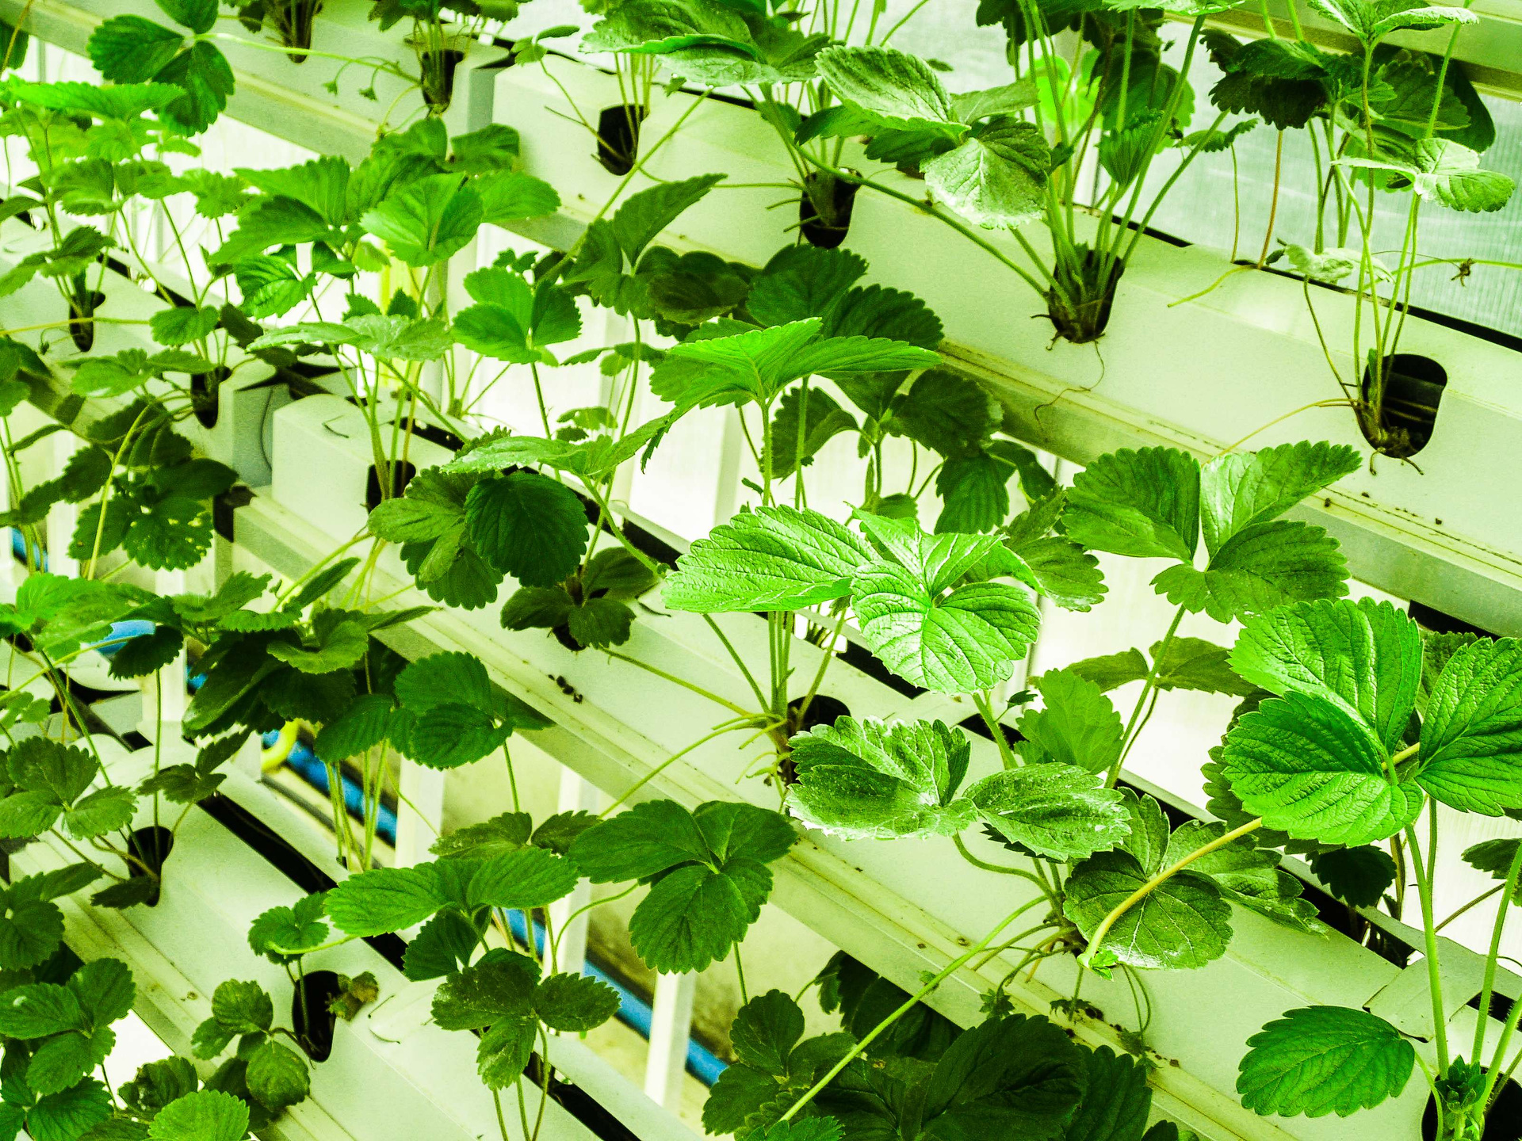
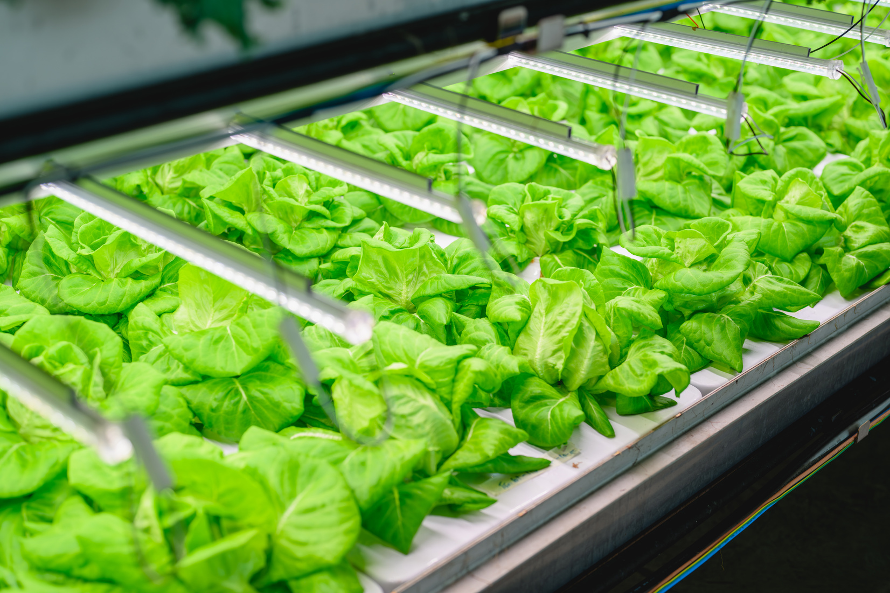
TECHNOLOGIES USED
1️⃣ Deep Learning (Computer Vision) Engineering
Built a Convolutional Neural Network (CNN) with multiple layers to classify plant diseases.
Applied Batch Normalization, Max Pooling, and Dropout for optimization.
Used TensorFlow/Keras for model training and evaluation.
2️⃣ Feature Engineering
Extracted features from the second-to-last layer of the trained CNN model.
Used these extracted high-level image features for further classification.
3️⃣ Traditional Machine Learning (Decision Tree)
Applied a Decision Tree classifier on the extracted features to improve interpretability or efficiency.
4️⃣ NLP & Prompt Engineering
Used OpenAI’s GPT-3.5 Turbo for chatbot integration.
Applied prompt engineering to generate accurate, context-aware responses for farmers.
This is a hybrid AI approach, combining Deep Learning, Feature Engineering, Decision Trees, and NLP to create a powerful and efficient AI system. 🚀🌿
4o

Slide 7


Slide 8
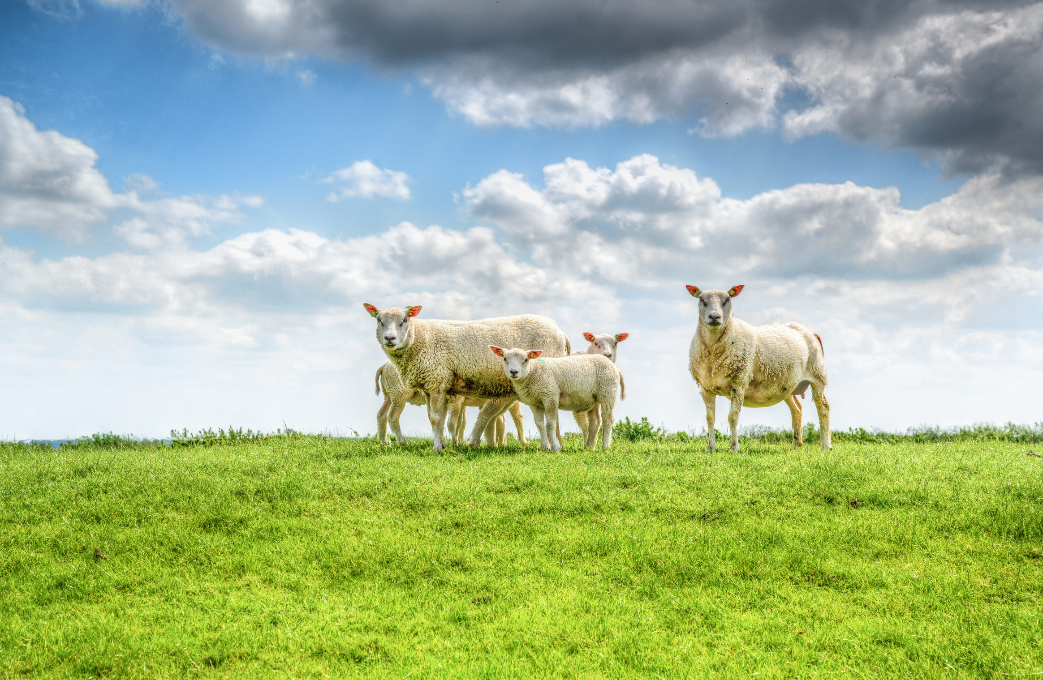
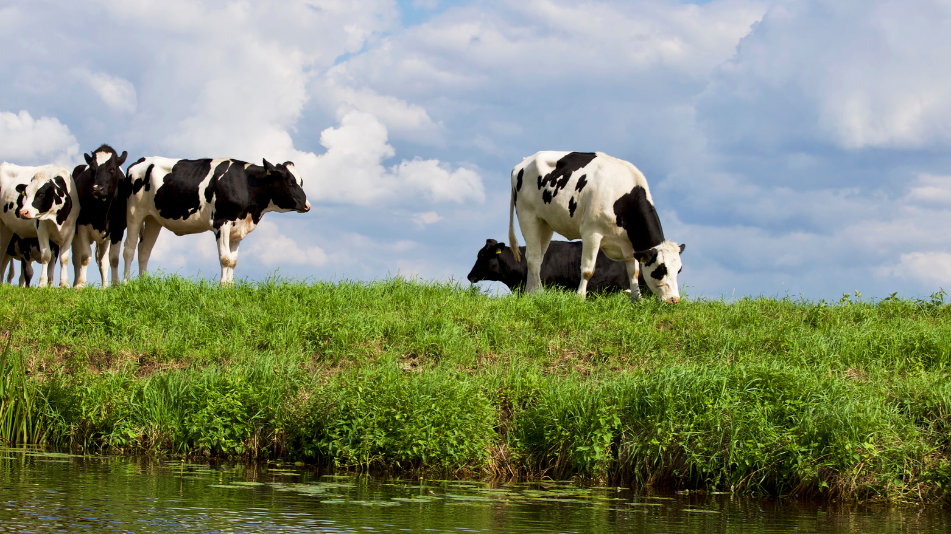




SALFORD & CO.
CONTACT US
+91 8169155564
HTTPS://GITHUB.COM/HAREKRISHNA4747
JAYADITYAARORA2007@GMAIL.COM
SVKM’S NMIMS SHIRPUR

Slide 9
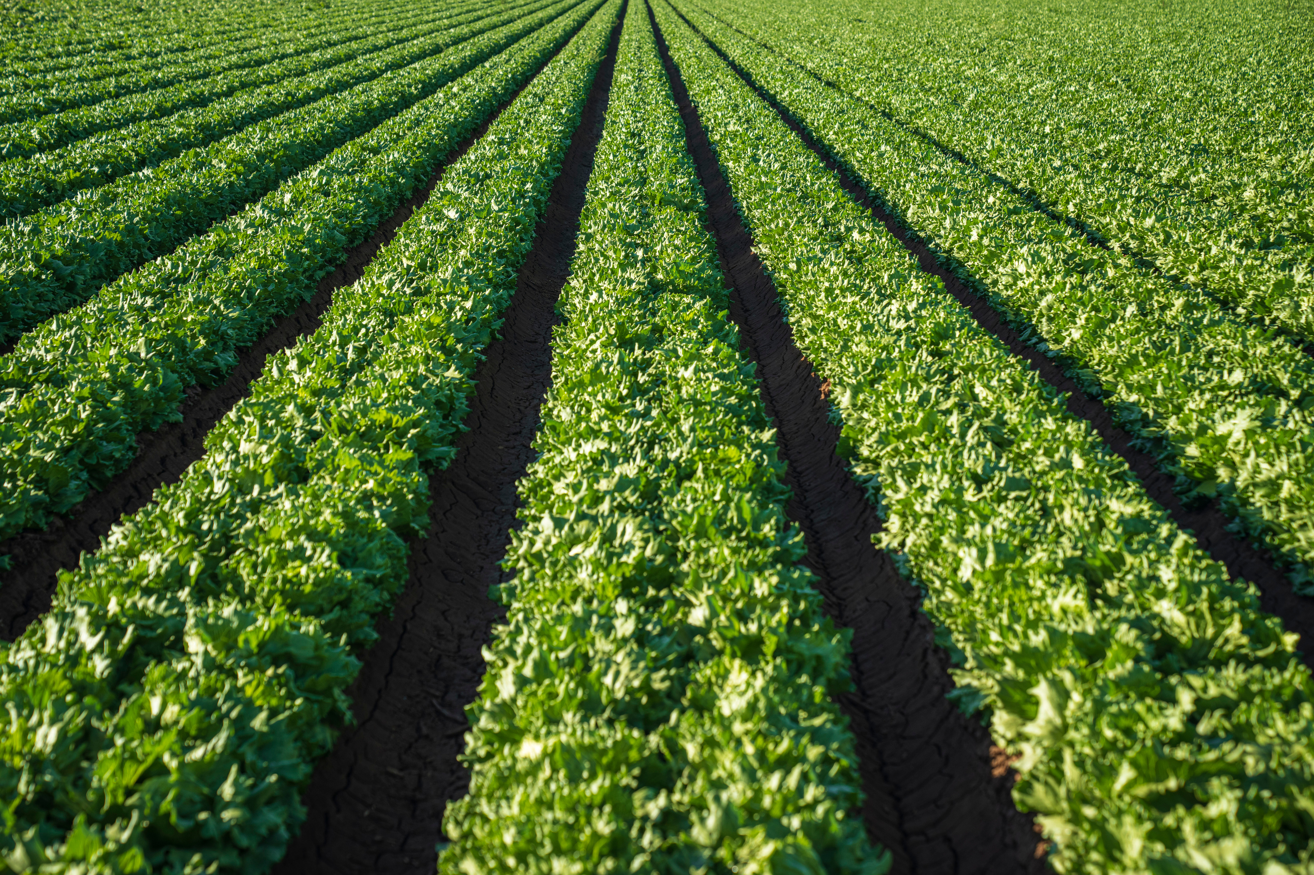

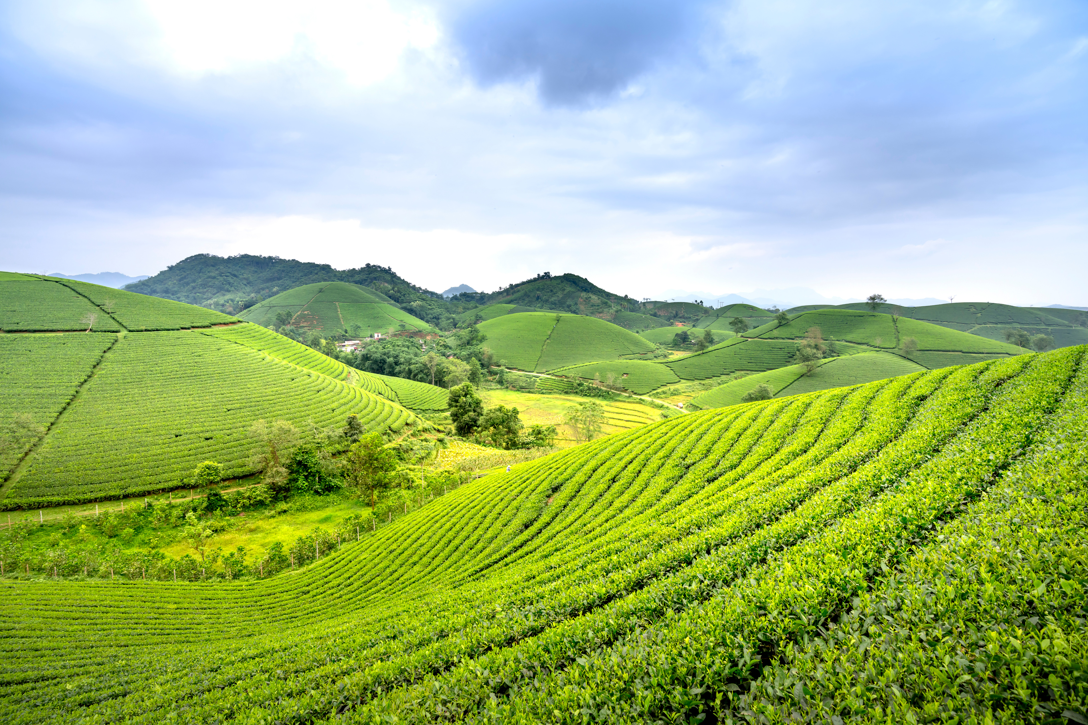
SALFORD & CO.
THANK YOU

